Slide 1


Starting a consulting business in 10 Minutes or less

Slide 2
What we will cover
Getting Started
Can You Sell?
What About Customers?
What Should You Sell?
Final Thoughts

Slide 3
Getting Started

Slide 4
Do this…
Think of a cool name for your business or just do business under your name
Create a sole proprietorship and register if needed in your state
If you have a cool name you may also need to register the DBA
Notes:
https://www.nolo.com/legal-encyclopedia/50-state-guide-establishing-sole-proprietorship.html
https://www.corpnet.com/blog/business-need-dba/

Slide 5
Don’t Do this…
Domain name (just yet)
Registered Trademark
Anything else that requires money

Slide 6
Can you sell?

Slide 7
I can’t sell
Partner with someone who can (make sure you own 51% of the business)
Go to places like Upwork to do the selling for you (you will lose control of WHAT to sell somewhat)
Try selling even if it scares you (you never know what will happen)
Notes:
https://webflow.com/blog/freelance-websites

Slide 8
What about customers?

Slide 9
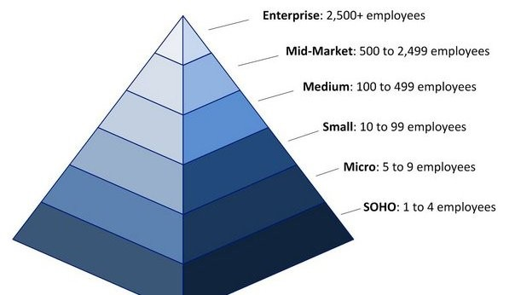
What space should you target?
Notes:
https://www.linkedin.com/pulse/you-looking-grow-revenue-2016-migrating-down-market-smb-phelan

Slide 10
What should you sell?

Slide 11
Gpts are quick and easy
The best solutions will be for internal use of content
Custom GPTs are the way to go in this space
Focus on reference information that needs to be accessed in a conversational way
Make a compelling demo

Slide 12
Keep in mind
Require the people using the GPT’s to have a team plan
Make sure the GPT is only viewable to the team
Set expectations up front on cost per user for the account
Make sure to include yourself for an account (until the job is done at least)
Try to get a support plan in place for ongoing updates and maintenance

Slide 13

GPT Internal solution demo example
Notes:
https://www.superiorhealthplan.com/providers/training-manuals.html
file:///E:/Downloads/nursing-facility-provider-manual.pdf
What are the key things I should know?
What is the provider portal support information?
Can you give me the important phone numbers in a table for quick reference?
您能否在表格中提供重要的电话号码以供快速参考？

Slide 14
If you are more skilled, use the api
Use GPT’s to rapidly prototype a solution
Pitch it to a customer
Use code (or a no code product) to incorporate the solution as needed
Notes:
https://www.chatbase.co/

Slide 15

API solution demo example
Notes:
https://www.houstonfootankle.com/
My feet hurt what do I do?
Do you treat diabetic foot pain?

Slide 16
Final Thoughts

Slide 17


